Slide 1
Diabetic Retinopathy Detection Using Retinal Images
Akshar Patel
Khushi Shah
Dhruvi Sojitra
Prepared By :

Slide 2
Table of contents
01
Introduction
02
About Retinopathy
03
Retinopathy Stages
04
05
Aim and Motivation
Statistical Data
06
Approach
07
Results
08
Prototype

Slide 3
01
Introduction

Slide 4
Introduction
Diabetic Retinopathy is caused by the damage to the blood vessels of light sensitive tissue at the back of an eye(retina).
Diabetic Retinopathy is the most common cause of vision loss among working-age diabetic adults,characterized by damage to the blood vessels in the retina due to high blood sugar levels.
The condition can develop in anyone who has Type 1 or Type 2 Diabetes.
If an individual has been living with diabetes for an extended period without controlling their blood sugar levels, they may experience complications with their eyes.

Slide 5
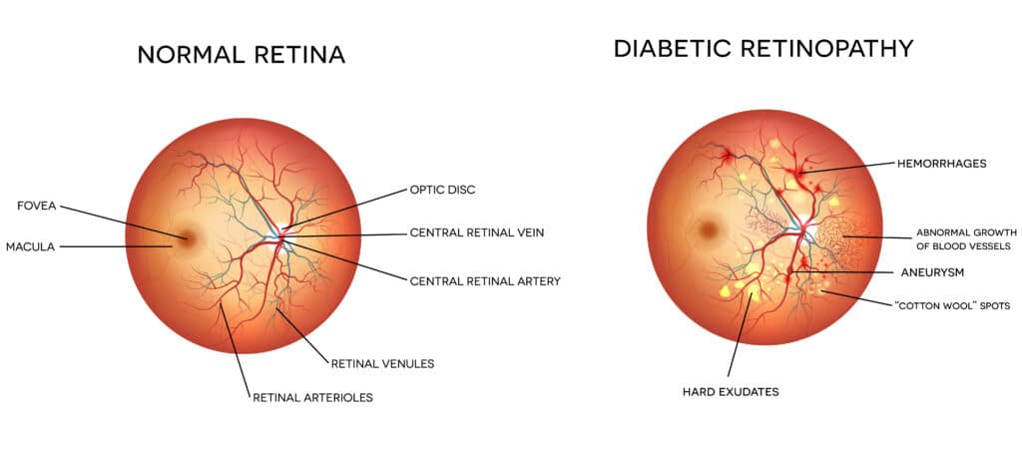
Comparison
02
In Diabetic Retinopathy there is a growth of Abnormal Blood Vessels in Retina.
This blood vessels in retina may get swallowed and it leaks fluid.

Slide 6
03
Stages

Slide 7
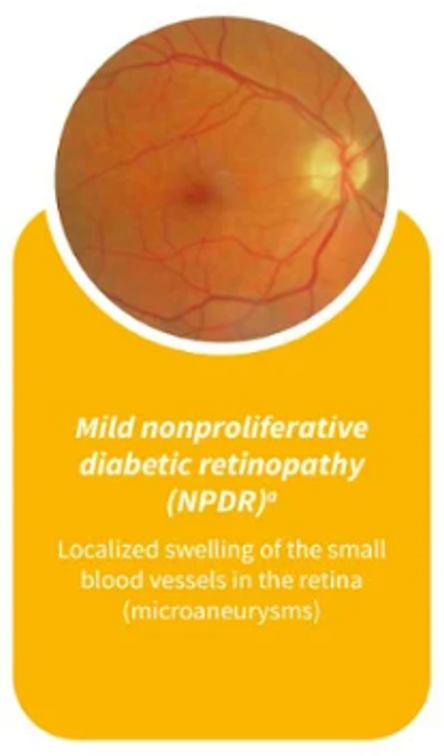
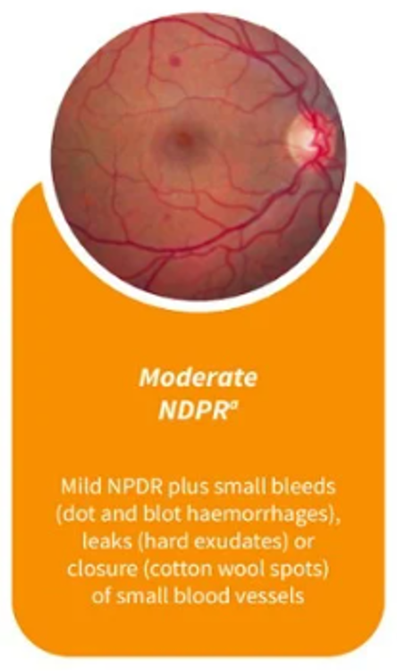
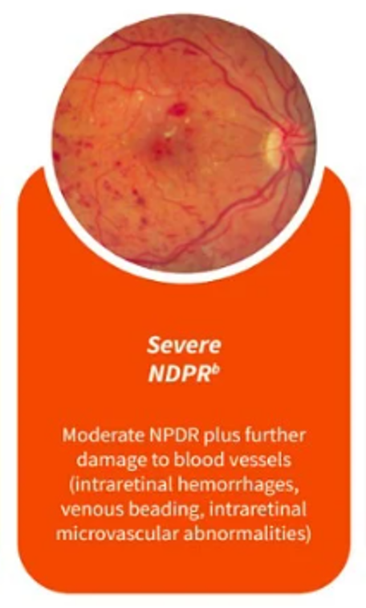
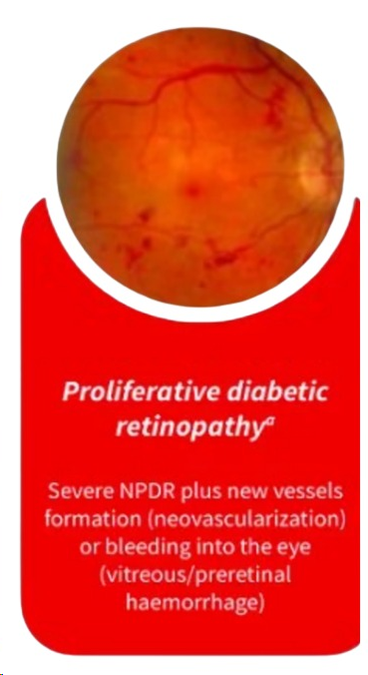
Diabetes Retinopathy Stages
Mild
Non Proliferative
Moderate
Non Proliferative
Severe
Non Proliferative
Proliferative
At this stage, the tiny blood vessels futher swell up, blocking blood flow to the retina and preventing proper nourishment. This stage will only cause noticeable signs if there a build-up of blood and other fluids in the macula, causing vision to become blurry.

Slide 8
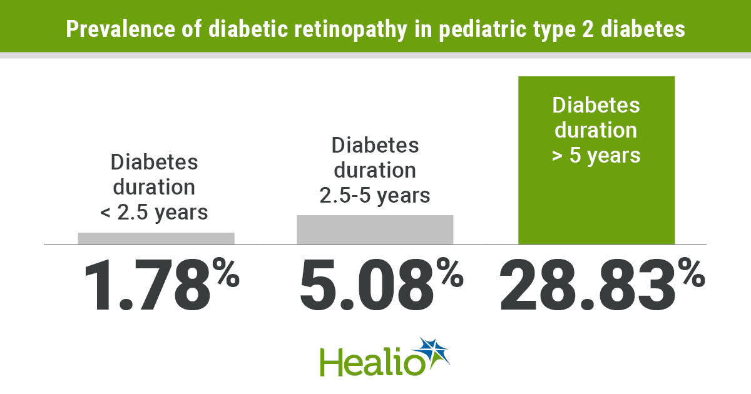
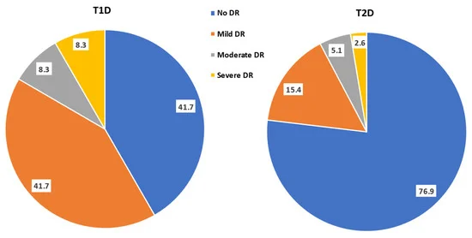
Statistical Data
04
Estimated number of people with Diabetes in 2022: 422 million
Estimated number of people with Diabetic retinopathy in 2022: 108 million
Estimated number of people with Type 1 Diabetes in 2022: 30 million (around 7%)
Estimated number of people with Type 2 Diabetes in 2022: 392 million (around 93%)
src : https://doi.org/10.3390/biomedicines11041222

Slide 9
Aim & Motivation
05
Aim: Develop a robust system for early detection of diabetic retinopathy.
Objective: Leverage machine learning, computer vision, and image processing for automated detection.
Goal: Accurately analyze retinal images, identify Different Stages of Diabetic Retinopathy.
Potential Benefits:
Reduce blindness.
Improve patient outcomes through early detection and treatment.
Enhance care availability, especially in underserved communities.
Support ongoing research and development in medical imaging, Deep learning, and healthcare technology.
Ultimate Aim: Assist healthcare professionals in diagnosing diabetic retinopathy more efficiently and accurately, thereby improving global public health outcomes.

Slide 10
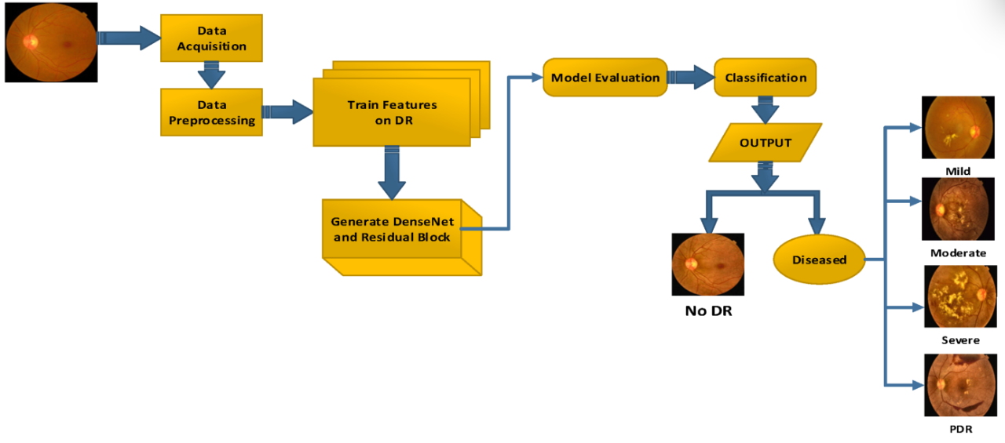
Approach
06

Slide 11
07
Results

Slide 12
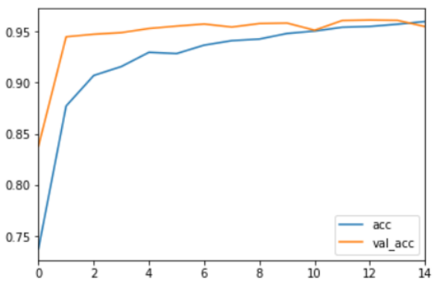
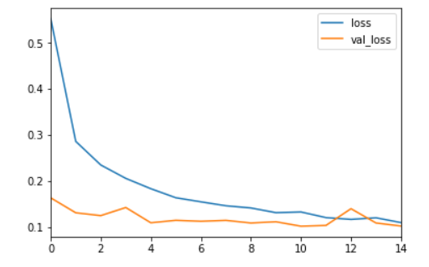
Acc Vs Val Acc
Loss Vs Val Loss
Training Accuracy : 95.02%
Validation Accuracy :94.96%
Sensitivity : 93.82%
Specificity : 98.32%
Training Loss : 0.0442
Validation Loss : 0.1336
Avg. Precision for each Classes : 83.22%
Avg. Recall for each Classes : 83.22%

Slide 13
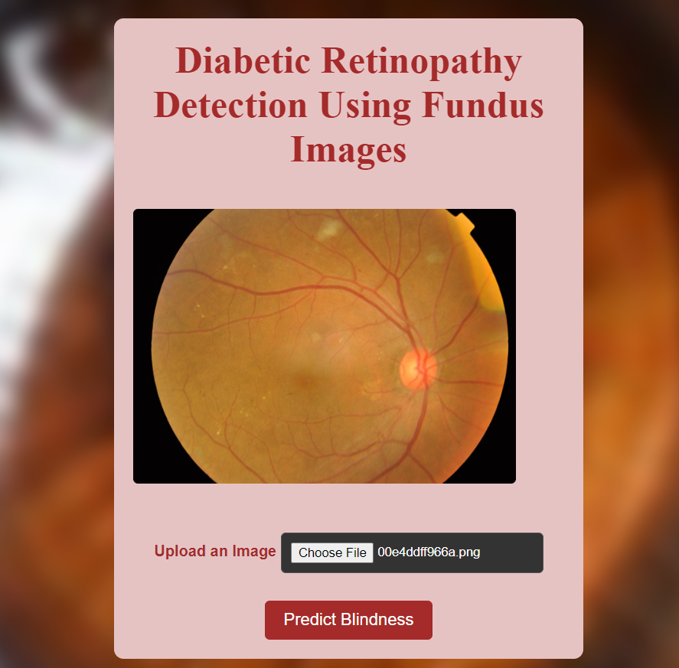
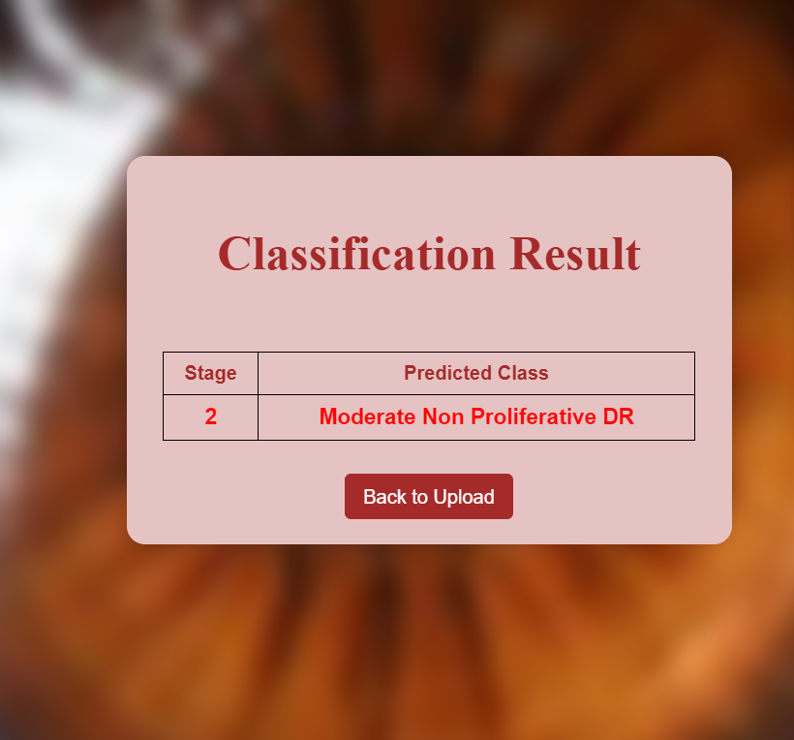
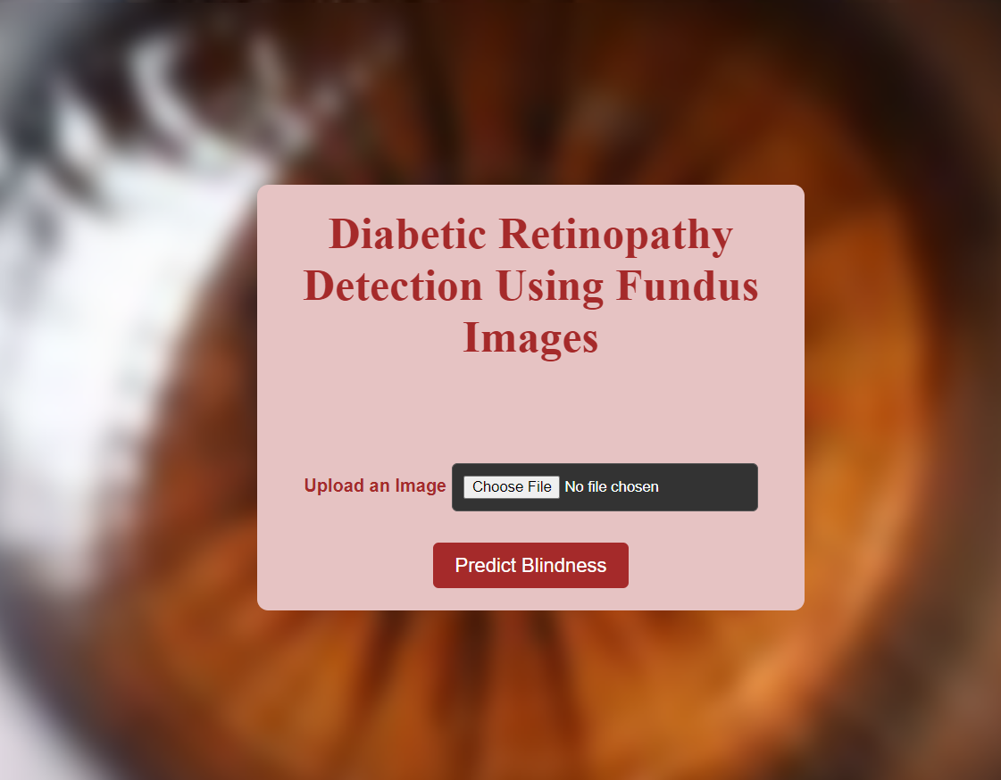
08
Prototype

Slide 14
Thank You

